Slide 1
Google File Stream
Google Drive Updates

Slide 2
What is Google File Stream?
Desktop application that lets you access all of your Google Drive files on demand.
Files are stored in the cloud, not on your computer, but they look like they are stored on the G: drive on your computer.
Any changes you make to files on the G: drive are automatically synced with the cloud.
File Stream is an optional app. You can continue using Google Drive without installing File Stream.

Slide 3
New Features in File Stream
Quickly see all your Google Drive files in Finder/Explorer (including shared drives).
Browse and organize Google Drive files without downloading them to your computer.
Choose which files or folders you'd like to make available offline.
Open files in common apps like Microsoft Office and Adobe Photoshop.
Mount Holyoke Google accounts have unlimited storage.
Notes:
Emphasize #4 – opening common apps.
Old Google Drive – editing Word files required an extension in Chrome.
Demo changing a Word doc – changes sync with Word doc in Google Drive.

Slide 4
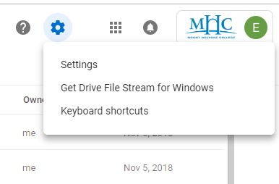
Installing Google File Stream
Go to Google Drive.
Click the Gear button in the upper right.
Click Download Drive File Stream for Windows

Slide 5
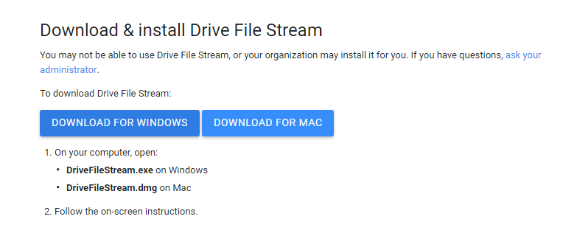
Downloading the File

Slide 6
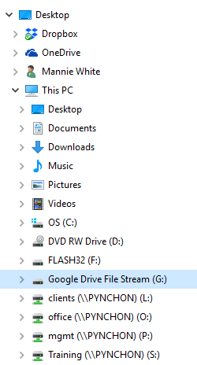
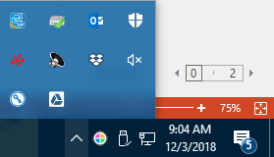
After Installation
Google Drive File Stream will appear in File Explorer with a Drive letter (G:).
Click on the drive to view files and folders.
A Drive icon will appear in the Windows notification area.

Slide 7
Troubleshooting
If Google Drive does not show up in File Explorer, and there is no icon in the Notification Area:
Click into the Windows 10 Search box.
Type “Google File Stream.”
Reboot the computer, if necessary.

Slide 8
Making Files Available Offline
By default, Google does not store copies of files on your computer.
Accessing your files requires an Internet connection.
To make files available offline, right-click a file/folder, and select Drive File Stream / Available Offline.
A copy of the file will be stored on your computer, taking up space on your hard drive.

Slide 9
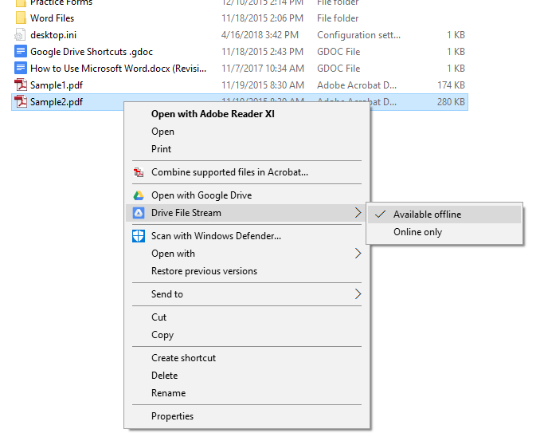

Slide 10
Offline Files
File Stream doesn't allow you to make files available offline if they are shared.
This is by design so you don't replace files people have worked on while you were offline when you reconnect.
The offline option is grayed out for files created with Google apps (docs, sheets, slides).
To make all Google files available offline, change Google Drive settings.
Notes:
Demo: Upload two Excel files and convert one to Google Sheets.
Check offline settings in Windows File Explorer for each file.

Slide 11
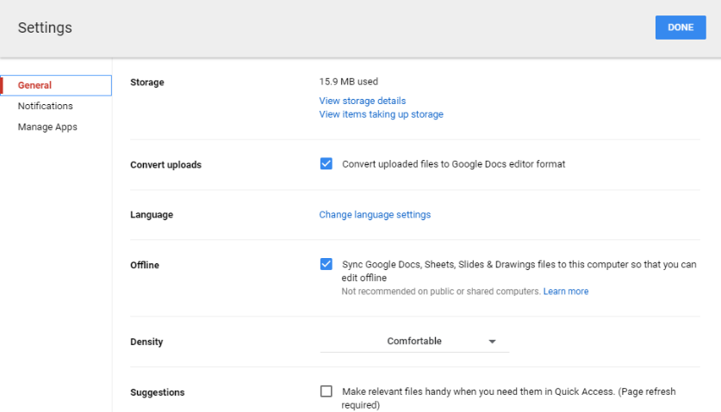
Settings – Sync Offline Files

Slide 12
Backup and Sync
As of May, 2018, Google shut down the old local Google Drive application.
It has been replaced by Google Backup and Sync, designed primarily for home users.
If you are using File Stream, it is recommended that you don’t also install Backup and Sync, which can be confusing to users and may result in duplicate files stored locally.

Slide 13
Google Shared Drives
Google Drive Updates

Slide 14
Shared Drives
A new feature in Google Drive that provides shared spaces where teams can create and store files.
Shared drives have their own section within the Google Drive interface.
Individuals can be members of multiple shared drives.
Each shared drive can have different members and permissions.
New files can be created or uploaded straight into a shared drive, and existing files can be moved into it.
shared drives solve one of G Suite’s biggest problems: shared data loss.

Slide 15
Shared Data Loss
In Google Drive, files and folders are owned by the person who creates them.
Shared folders often end up with files and folders owned by different people.
If one of the people leaves the organization and his/her account is deleted, all the files and folders owned by them are also deleted.
Loss of data can also occur when users move shared files out of shared folders.
Notes:
While both the end-user and domain administrator do have the ability to transfer ownership of shared data, this is difficult to manage and enforce – particularly in large organizations.

Slide 16
Shared Drives vs. Shared Folders
Shared drives are similar to shared folders, but include two additional features to protect against data loss.
Enhanced Access Permissions
Team-based Data Ownership

Slide 17
Enhanced Access Permissions
ROLE | ALLOWED ACTIVITIES
Manager | Manage members and drive settings as well as upload, edit, move and delete files
Content Manager | Upload, edit, move and delete files
Contributor | Upload and edit files
Commenter | Comment on files
Viewer | View files
Notes:
Users who are not managers or content managers will see an error message when they try to move a file.

Slide 18
Team-Based Ownership
Unlike shared folders, shared drives are not owned by individual users.
Shared drives are owned by the team itself.
Eliminates data loss when a former employee’s account is deleted.

Slide 19
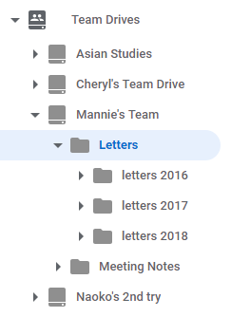
Organizing Files
Unlike shared folders, shared drives can contain subfolders.
Easier to organize and find files.

Slide 20
How should organizations use shared drive?
Shared drives can be used to implement a project, faculty, department or organization-wide shared drive structure.
Many schools and businesses use shared folders for this purpose now.
Consider moving shared folder structures into shared drives.
Create a set of appropriate shared drives
Assign membership permissions
Move in shared content
Use “Content Manager” access with caution.
Notes:
This is particularly relevant if your colleagues are not yet familiar with the consequences of moving or deleting shared data.
Giving only selected people ‘Content Manager’ permission reduces the likelihood of data be mistakenly deleted or removed from the shared drive.
However, be mindful that shared drive members with ‘Contributor’ access will not be able to move files between folders, which could be frustrating if they create a file in the wrong location.

Slide 21
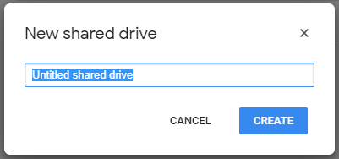
Creating a Shared Drive
Open Drive.
In the left navigation, click shared drives.
At top, click New.
Enter a name.
Click Create.
Notes:
If you can’t create a shared drive, contact your admin. It may be turned off.
Exercise: Create a new shared drive. Name it <<your name>>’s team.

Slide 22
Add Members and Set Permissions
In the left navigation, click a shared drive.
At the top, under the shared drive name, click +Add Members.
Add names, email addresses, or Google Groups.
To change the permission from Content Manager, select a different permission level.
(Optional) Enter a message.
(Optional) If you don’t want to send notifications, select Skip sending notification.
Choose an option:
Click Send to send notifications
Click Add if you don't want to send notifications.
Notes:
Add two members to your team:
Neighbor – make Contributor.
Me – make Viewer.

Slide 23
Change Member Permissions
To change member permissions, you need Manager permission.
In the left navigation, click a shared drive.
At the top, next to the shared drive name, click the Down arrow Manage members.
Next to a member’s name, click the Down arrow and select a new permission.
Click Done.
Notes:
Change my permission to Content Manager.

Slide 24
Remove Members
To remove members, you need Manager permission.
In the left navigation, click a shared drive.
At the top, next to the shared drive name, click the Down arrow Manage members.
Next to a member’s name, click the Down arrow and select Remove member.
Click Done.

Slide 25
Creating Folders in a Shared Drive
Create a new folder:
In the left navigation, click a shared drive or existing folder.
Click New > Folder.
Enter a folder name.
Click Create.
Upload an existing folder from your computer:
In the left navigation, click a shared drive folder.
On your computer, drag an existing folder into a shared drive. Or, click New> Folder upload. Navigate to the folder and open it.
Notes:
Exercise:
Create two new folders – Letters and Budgets.
Demo how to add a folder to a Team Drive in Windows Explorer.

Slide 26
Adding Files to a Shared Drive
To add files to a shared drive, you need at least Contributor permission. Any files you add are owned by the team. If you leave the shared drive, your files remain.
In the left navigation, click a shared drive folder.
Drag an existing file to upload it from your computer. Or, click New and choose an option:
To create a file, select the file type you want to create, such as Google Docs.
To upload a file, select File upload. Navigate to the file and open it.
Double-click a file to open it.
Notes:
Create a new document in your own shared drive in the Letters folder
Create from MHC Letterhead template in My Drive. Type some text and name it Letter 1. Then drag into shared drive Letters folder.
Create a new spreadsheet in your neighbor’s shared drive in the Budgets folder.
Create a new blank sheet.
Name the file Budget 2018.
Enter today’s date in A1.
Create a new document in your neighbor’s shared drive and attempt to move it to My Drive.
Confirm that you have Contributor access.
Create from MHC Letterhead template. Type some text and name it Letter 2.
Attempt to move the doc from the shared drive to My Drive.
You should not be able to move it.

Slide 27
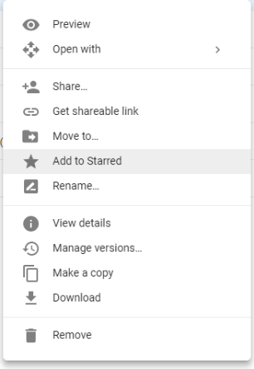
Star Important Files
Flag important files or folders to find them quickly later. Just right-click a file or folder and select Add to starred.
To see all your starred files and folders, in the left sidebar, click Starred.
Notes:
Add a star to the Letter1 doc.

Slide 28
Moving Files
You can move any file you own into a shared drive, whether it’s from another Drive location, or from your computer or mobile device.
To move files between shared drives or from My Drive into a shared drive, drag the files into the destination shared drive folder.
Note:
To move files between shared drives, you must have Manager access to the original shared drive and at least Contributor access to the destination shared drive.

Slide 29
Delete a File
You must have Content Manager access to delete a file.
Click the file you want to delete.
Right-click and select Delete for everyone.
Notes:
Delete Letter 2 in the Letters folder of your own shared drive.
If someone accidentally deletes a file, you can restore it (for 30 days).

Slide 30
Restoring a File
You must have Contributor access or higher to restore a file.
In the left navigation, click a shared drive.
At top, next to the shared drive name, click the Down arrow - View trash.
Right-click a file and select Restore.
Notes:
Restore Letter 2

Slide 31
Search for Files
Find a file in a specific shared drive:
In Search, click the Down arrow.
Next to Location, double-click Anywhere.
Double-click shared drives and select a particular shared drive.
Click Select.
(Optional) Enter additional search options, such as the file type or date the file was modified.
Click Search.
Notes:
Search for Meeting notes in all shared drives.
Search for Meeting Notes in your neighbor’s shared drive.

Slide 32
Share and Collaborate
Any files you put in shared drives are automatically shared with members of the shared drive.
You can also share shared drive files with people in your organization who aren’t members of the shared drive.
Notes:
When you share a file with someone who is not a member of the shared drive, you will not have the same permission levels.
(No distinction between Contributor, Content Manager, and Manager access in standard Google Drive Files.)

Slide 33
Shared Drive Settings
Click the drop-down arrow to the right of the team name and select Shared Drive Settings.
Allow sharing outside of Mount Holyoke College
Allow sharing with non-members of the shared drive
Allow commenters and viewers to download, copy and print files in the shared drive

Slide 34
Change the Theme
Click the drop-down arrow to the right of the team name and select Settings.
Select Change theme / Pick from gallery.
Create a custom theme from files in your Google Drive.

Slide 35
Delete a Shared Drive
Before you can delete a shared drive:
The shared drive has to be empty
You need to have Manager access.
On the left, click shared drives.
Right click the shared drive you want to delete.
Click Delete shared drive.

Slide 36
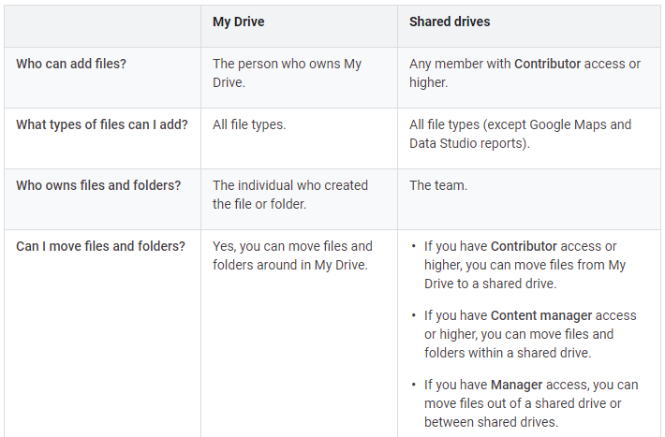

Slide 37
